Slide 1
Data Analysis on
Home Credit Default Risk
Notes:
I have combined my strengths in data analysis and Python with the financial domain.
I am going to have a presentation on data analysis on loan repayment data of Home Credit.

Slide 2
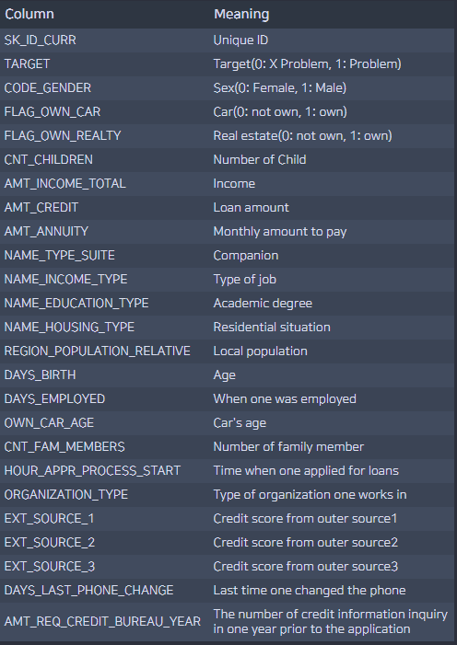
Analysis on Loan Repayment
Introduction to data and motive for analysis
Development Environment
Language: Python
Source of data:
Kaggle / Home Credit
Default Risk
Used Domain Knowledge:
Financial data
Objective:
Analyzing the factors affecting the loan payment status and drawing a conclusion
Introduction to data
Home Credit Internal Data
Personal Information
Detailed Information on loans
Whether the debtor has paid the loans or not
Analysis design
Modeling
Identifying the influence of features on the model
Relationship between the 5 most contributing factors and whether the loan is paid or not
Notes:
I conducted the analysis using the data posted by Home Credit. Home Credit is a non-bank financial institution that lends money to people with low credit ratings. The purpose of my analysis is to find out what characteristics or variables of the debtor have affected the debtor's ability of repayment. First, let me tell you the importance of this data analysis.
Nowadays, it is not that difficult for non-experts to make artificial intelligence models. These days, the related fields have developed a lot, so anyone with just three lines of code can create a high-performance AI model that can distinguish photos of cats and dogs with 95% accuracy. When it comes to distinguishing dogs from cats, artificial intelligence will not
cause a big problem even if it misclassifies the photo. But if artificial intelligence makes a wrong decision in sensitive areas such as healthcare and finance, it can cause big problems
Because they are dealing with people’s lives and money, so in these areas, explanation of the AI model’s decision is necessary.
For example, if Bank A gives the customer's data to AI and it predicts that they should not lend money to the customer, the bank should be able to give a reasonable explanation to the customer. However, the deep learning model, called the black box, learns in a way that is too complicated for humans to interpret. So they can decide whether to lend money to customers or not, but it's difficult for humans to interpret or explain the rationale for going to that decision. In other words, not many people can answer the question of why? in the model's judgment.
So I'm going to use an interpretable machine learning model to not only predict the ability of the customer to pay back their debts,
but also analyze which variables have the most influencing effect on the prediction. If you look at the table provided by Home Credit, there are variables that represent personal and debt information such as the debtor's gender, age, and amount of debt.
The TARGET value in the table indicates whether he has paid back successfully. 0 indicates successful payback and 1 indicates there was a problem.
With this data, I created an interpretable machine learning model called XGBoost, and I interpreted this model to visualize the results.

Slide 3
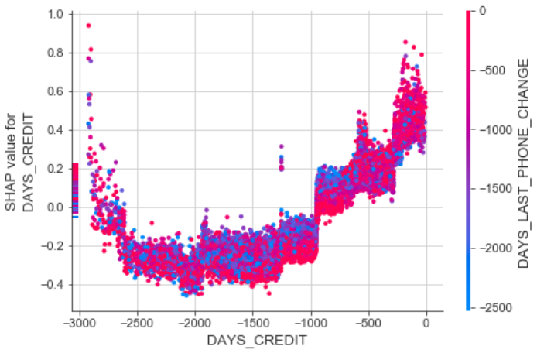
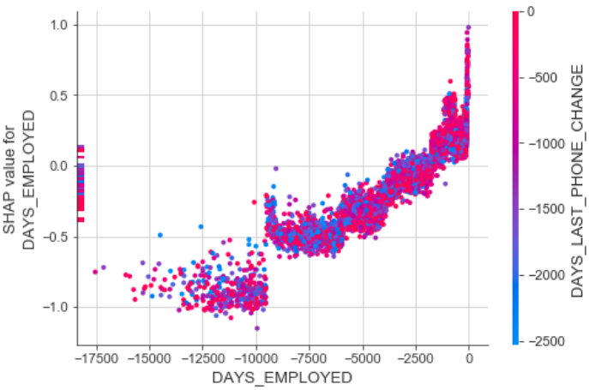
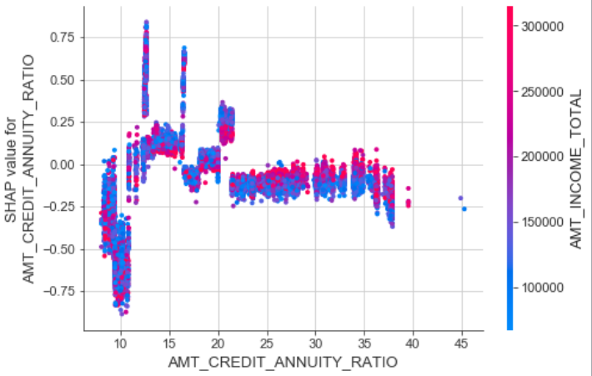
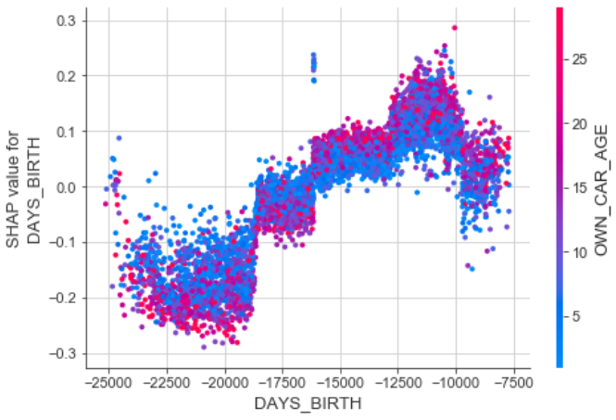
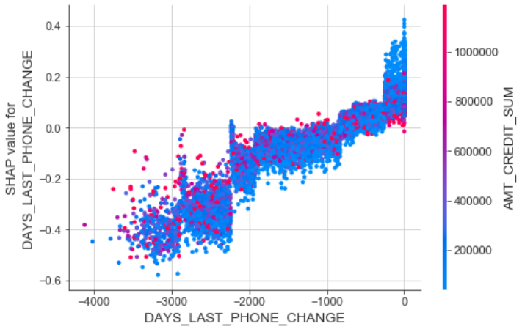
Analysis on Loan Repayment
Modeling
DAYS_CREDIT
The closer the last date of loan, the less likely to repay the loan
DAYS_EMPLOYED
The longer one works, the more likely to repay the loan
Singularity: -9000 day = 25 years
AMT_CREDIT_TO_ANNUITY_RATIO
12~21 months: Low chance of repayment
~12: High chance of repayment
DAYS_BIRTH
The older the person, the better the repayment ability
Singularity: -18750 days = 51 years
DAYS_LAST_PHONE_CHANGE
The more recent one changes the phone, the less likely to repay the loan
Notes:
As I said, AI models make prediction by learning the patterns in data. But this training and pattern finding process is too complicated for humans to understand.
However, with the help of SHAP value, we can interpret which variable the model used the most for the prediction
I interpreted the model through SHAP value and visualized the top five variables that affected the model's predictions the most.
SHAP value is an indicator of how much each variable affected the prediction.
In other words, if a variable has a high SHAP value, the variable has a significant impact on the model's prediction.
Conversely, if the SHAP value is 0, this variable has no effect on the model's prediction.
If you look at the first graph at the top left corner, the X-axis represents a variable, which is DAYS_CREDIT for this graph, and the Y-axis shows how this variable affected the prediction.
Negative Y-values mean that they are affecting the lowering of prediction value.
Since our data indicate that there is no problem in repayment when the prediction value is zero, having a negative Y-value means that the probability of loan repayment increases.
Conversely, positive Y values are affecting the increase in the prediction value. A prediction value of 1 indicates a problem in the repayment process, so having a positive Y value means a decrease in the probability of loan repayment.
Let me explain what each variable means.
DAYS_CREDIT indicates an average difference between the previous and current loan days if a loan has been made before. -1000 means that the debtor took out another loan about three years ago. As you can see from the graph, the more recent a previous loan was made, the more positive the y-value is,
Which means decrease in the repayment ability
DAYS_EMPLOYED variable indicates how many days before the current date of the loan you had a job.
As it can be seen in the graph, the more recent debtor got a job, the less likely he will repay the loans.
And there is a sharp increase in debtor’s ability to repay after -9000 days, which is equivalent to 25 years.
AMT_CREDIT_TO_ANNUITY_RATIO variable represents the total loan repayment period.
When the period was between 12 and 21months, the repayment ability was low
However, we can see the drastic increase in repayment ability when the period was shorter than 12 months.
DAYS_BIRTH indicates the age of the debtor.
We can see that the ability to repay loans increases as the age of the debtor increases.
And there is a drastic increase in the repayment ability at age of -18500 days, which is equivalent to 51 years.
DAYS_LAST_PHONE_CHANGE variable indicates when the debtor last changed his phone.
The longer the one last changed his cell phone, the higher his solvency was.
We have looked at the 5 factors that had the most impact on the prediction.

Slide 4
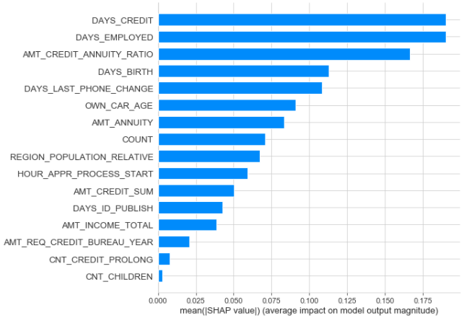
Analysis on Loan Repayment
Analysis Result
Q : Influencing Factors?
A: Top 5 Factors
DAYS_CREDIT: Previous loan date
DAYS_EMPLOYED : Employment period
AMT_CREDIT_ANNUITY_RATIO: Loan period
DAYS_BIRTH: Age
DAYS_LAST_PHONE_CHANGE :
Last time changing the phone
Model :
XGBoost
Why XGBoost?:
In order to use tree-based model
Fast training speed
high accuracy
Importance of the features through SHAP value
Notes:
Finally, I am going to use SHAP value graph for each variable to summarize which variables have a lot of impact and which variables have a less impact.
As you can see on the previous slide,
Previous loan date, the time of employment, the period of loan, age, and the time of the change of cell phones had a significant impact on
determining the debtor's ability to pay back.
Unexpectedly, the number of children and total income did not have as much impact as I thought.
This type of data analysis tells the financial institution which factors to focus on when they lend money,
Drawing insight through this data analysis is one of my strengths and it will be greatly helpful to the company's work on data handling and analysis.

